Slide 1
Fixed point collisions and tensorial order parameters in Luttinger semimetals and some popular field theories
Igor Herbut
(Simon Fraser University, Vancouver)
Lukas Janssen (TU Dresden)
Igor Boettcher (Maryland)
Rome, September 2019

Slide 2
Outline:
1) Condensed matter motivation : (symmetry-poor real world)
Quadratic band touching in three dimensions, and the Luttinger Hamiltonian
Coulomb interaction and the scale-invariant (“non-Fermi liquid”) fixed point
Fixed point annihilation and the concomitant separation of scales
Spin-2 (tensor) order parameter
2) Field theory applications
Chiral symmetry breaking in QEDd<4 revisited
Interacting O(N) field theory above four dimensions

Slide 3
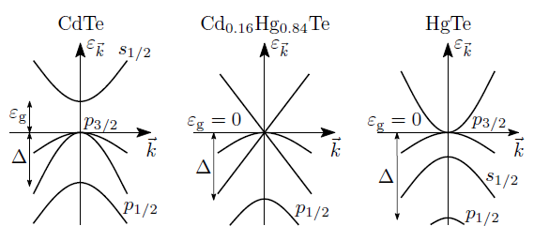
Gapless semiconductors with band inversion (gray tin, HgTe, YPtBi )
Luttinger (spin-orbit) Hamiltonian (p-orbitals, J= 3/2) (Luttinger 1956)
with (rotationally symmetric) eigenvalues

Slide 4
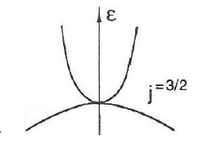
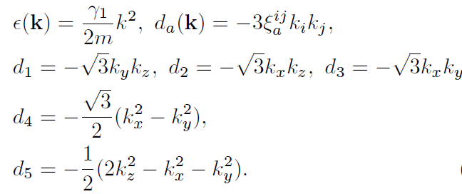
Luttinger Hamiltonian a la Dirac:
where,
are l=2 (real) spherical harmonics.
Five 4 x 4 Dirac matrices satisfy Clifford algebra:

Slide 5
Long-range Coulomb interaction (1/q^2) :
without the hole band, at ``zero” (low) density:
Wigner crystal
With the hole band filled and particle band empty: the system is
critical !
In the RG language, the charge flows with the change of cutoff, to one loop:
(Abrikosov, ZETF 1974; Moon, Xu, Kim, Balents, PRL 2013)

Slide 6
Below and near the upper critical dimension, dup = 4, the flow is towards a non-Fermi liquid fixed point, with the charge at
and the dynamical critical exponent Z < 2:
This implies power-laws in various responses, such as specific heat:
Emergent scale ( conformal ? ) invariance!
Cheap way to get a non-Fermi liquid phase in 3D !?

Slide 7
Generation of short-range interactions: (IH & Janssen, PRL 2014; Janssen & IH, PRB 2017, Boettcher & IH, PRB 2017)
with the free (Luttinger) part,
and long-range (Coulomb) and short-range (Coulomb) interactions

Slide 8
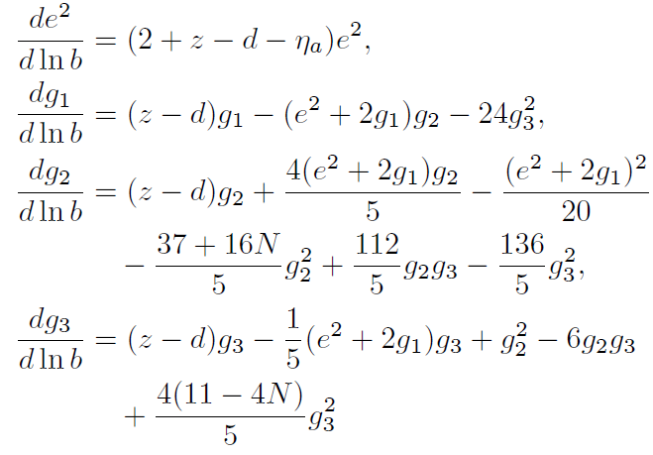
The RG flow of all the couplings: (one loop)
with,
and the “charge”

Slide 9
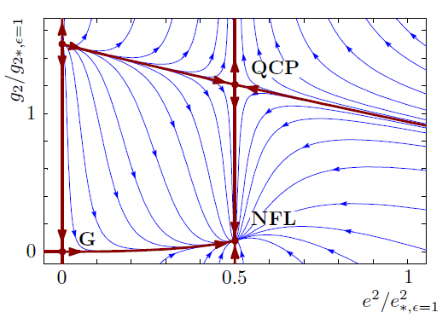
One-loop at face value:
close to and below d=4 there is a (IR stable) NFL fixed point, but also a (mixed-stable) quantum critical point at strong interaction:
They get closer, but remain separated in the coupling space!

Slide 10
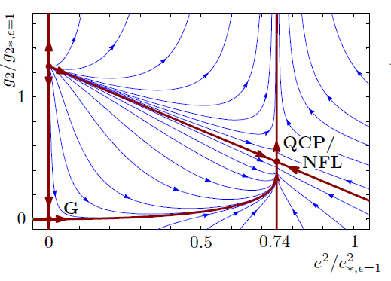
At some “lower” (non-integer) critical dimension d=dl NFL and QCP collide:
In one-loop calculation this occurs at , slightly above three dimensions.

Slide 11
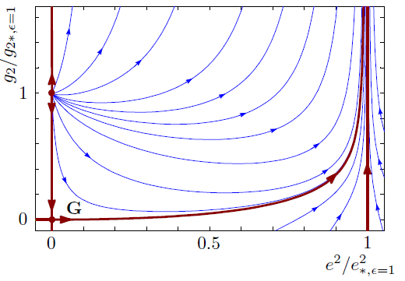
Finally, below dl the NFL and QCP become complex , and there is only a runaway flow left in the physical (real) coupling space:
g2 diverges at a finite scale: the system is unstable, towards a new phase
(gapped (Mott) insulator).
Scale invariance lost!

Slide 12
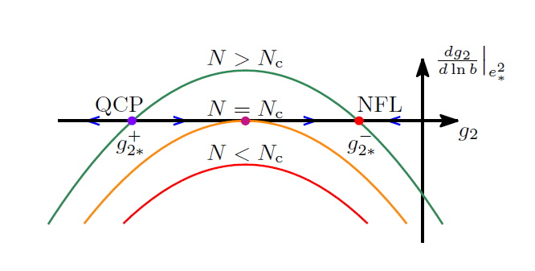
Fixed point collision and annihilation:
(Halperin, Lubensky, Ma, PRL 1974; IH & Tesanovic, PRL 1995;
Kaveh & IH, PRB 2005; Gies & Jaeckel 2006;
Kaplan, Lee, Son, Stephanov, PRD 2009; Nahum, PRX 2015, Gorbenko, Rychkov, Zan 2018 ….)

Slide 13
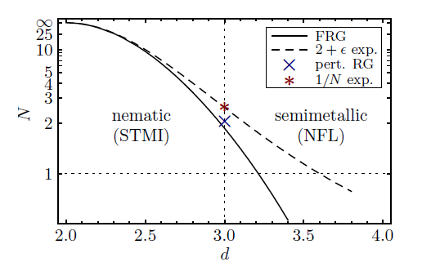
General number of fermions (N) and dimension (d):
Near d=2 the collision occurs in the completely perturbative regime:

Slide 14
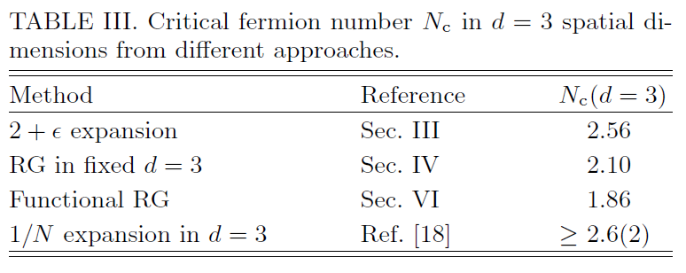
Critical number of fermions in d=3:
(Janssen & IH, PRB 2017)

Slide 16
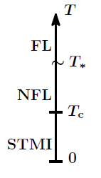
The fate of NFL: if dl is above but close to d=3, the flow becomes slow close to (complex!) NFL fixed point. The RG escape time is long:
with non-universal constants C and B. There is wide crossover region of the NFL behavior within the temperature window
with the critical temperature,
Characteristic energy scale for interaction effects
(Sherrington & Kohn, Halperin & Rice, RMP 1968)

Slide 17
Some numbers: (for HgTe)
small mass
high dielectric constant
still a reasonable
and (maybe) a detectable

Slide 18
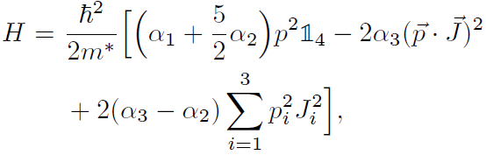
Cubic symmetry: realistic Luttinger Hamiltonian, cubic symmetry
contains particle-hole asymmetry and anisotropy parameters
with (generically) particularly slow flow of the anisotropy:

Slide 19
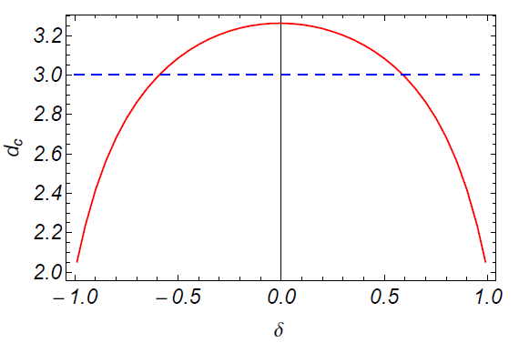
Flow of the charge is now
which lowers the critical dimension: (Boettcher & IH, PRB 2017)

Slide 20
Chiral symmetry breaking in QED3 revisited
Schwinger-Dyson, large-N, calculation of the mass gap
(Appelquist, Nash, Wijewardhana, PRL 1988; Pisarski, PRD 1984):
as the number of four-component Dirac fermions N
from below.
This should also be understandable as a fixed point collision and annihilation.

Slide 21
Consider QED near four space-time dimensions with (generated) quartic terms (Herbut, PRD 2016; Di Pietro et al, PRL 2016)
with
i. e. with additional (axial) current – (axial) current interactions.

Slide 22
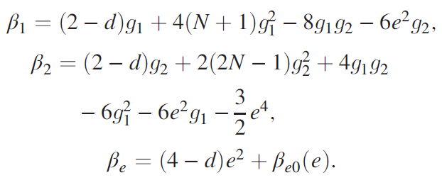
The flow in the IR ( ), one loop: (IH, PRD 2016)
and the charge beta-function precisely in d=4 is:
(Gorishny, Kataev, Larin 1991 (four loop))

Slide 23
Introducing linear combinations:
equations (almost) decouple
When N=0 the first equation decouples. At zero charge:
1) Gaussian stable FP
2) Critical FP
and two more (unimportant) FPs.

Slide 24
Note that when , then:
So a large positive indeed favors CSB.
Turning on a small charge by hand FP 1 (conformal phase) and FP 2 (critical point for CSB) approach each other.
At one loop and near d=4 the fixed points collide at
At which
at least are reasonably small.

Slide 25
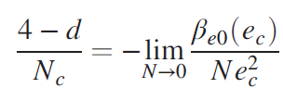
Equating the critical and the IR fixed point value of the charge yields
and finally
Compares well with other analytical approaches.
Numerically, CSB maybe only at N=0 ?
(Karthik and Narayanan, PRD 2016)

Slide 26
O(N) critical point above four (space-time) dimensions
Above four dimensions Wilson-Fisher fixed point moves to unphysical region and becomes IR unstable (bicritical):
(IH, A modern approach to critical phenomena (CUP 2007), p. 53)
Can it be understood as an IR stable FP of another theory?

Slide 27
Fei, Giombi, Klebanov (PRD 2014): consider
which is (log) renormalizable at d=6.
Below d=6 there is an IR stable fixed point for ( )
(Fei, Giombi, Klebanov, Tarnopolsky, PRD 2015)

Slide 28
Alternative formulation (IH and Janssen, PRD 2016)
Consider XY model (N=2):
Alternative Hubbard-Stratonovich decoupling
to motivate an another representation of the XY model:

Slide 29
For a general N:
is the number of components of second rank irreducible tensor. Completeness of the set of real symmetric - - matrices
So that
is just the original quartic term!

Slide 30
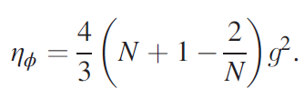
Alternative O(N) model: (IH, Janssen, PRD 2016)
which is also renormalizable in d=6. Right below d=6, one loop:

Slide 31
This flow has an IR stable fixed point for:
and again for
For N=2:
and for N=3:
and positive!

Slide 32
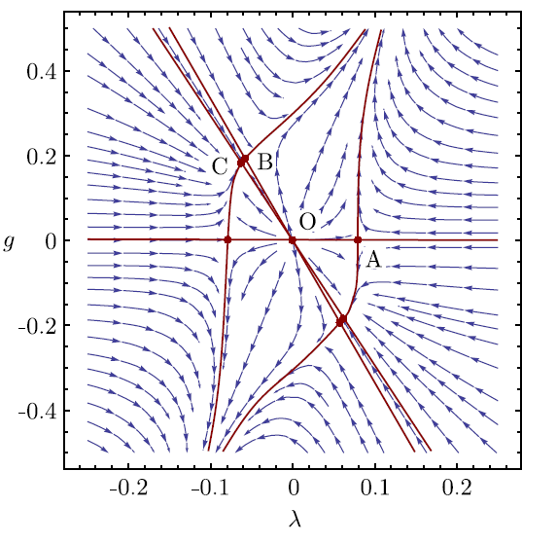
Flow for N=3:
For the fixed point A becomes stable, but runs to infinity as .

Slide 33
At N=3 at the fixed point the theory becomes:
with
and
It is invariant under SU(3) transformation:

Slide 34
Four-loop calculation: (Gracey, IH, Roscher, PRD 2018)
leads to critical exponents, but also to, for example:

Slide 35
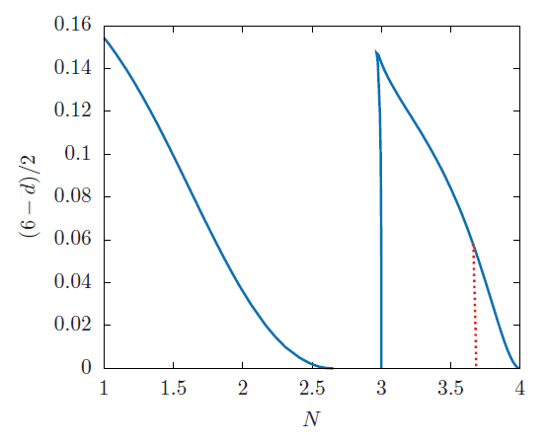
Conformal windows:
Annihilation is with Banks-Zaks-like fixed points near two right edges.
Anything left in d=5?

Slide 36
Conclusion:
Two examples of fixed-point collisions:
a) interacting Luttinger fermions in 3D semiconductors,
b) QED at low N; many others (scalar QED, Potts, QCD (?)…..)
Characteristic hierarchy of scales due to “walking”; gaps could appear “unnaturally” small
3) Tensor representation of the O(N) models: new IR-stable O(N)
fixed points close to d=6.
Possible non-triviality in d= 4, 5 ?

Slide 37
Di Pietro et al PRL 2016: neglect of e^4 terms gives
Fixed points near d=4 are at the line
Gaussian FP is pinned at
Critical point goes through it and destabilizes it at
4) From the leading order beta function for the charge then

Slide 38
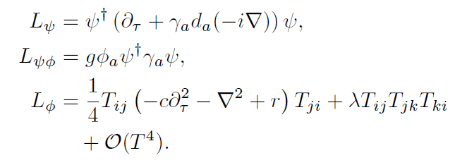
Yukawa-like field theory for the nematic (IR) critical point:
(Janssen & IH, PRB 2015)
where the nematic tensorial order parameter is
And are the five three dimensional Gell-Mann matrices.

Slide 39
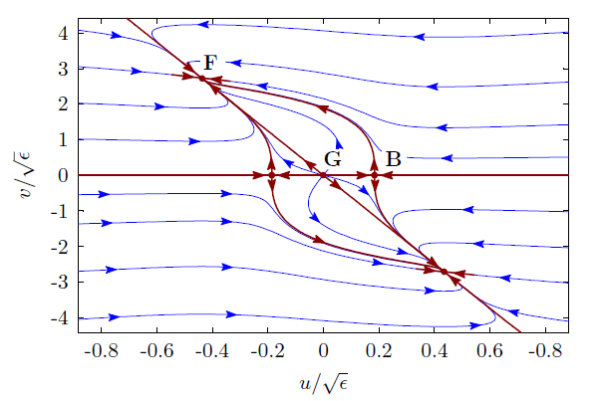
RG flow, close to four (spatial) dimensions:
“B”: “classical” nematic critical point (Priest and Lubensky, 1976)
“F”: new fermionic fixed point

